Slide 1
Designing Testable Applications
Part II: DB Integration & Legacy Code

Slide 2
Agenda
Objectives
Database Integration: Tips & Samples
Legacy Code Refactoring: Tips & Samples
Coding time!
Feedback
Summary

Slide 3

Objectives
Divulge the use of best practices such as unit & integration testing and continuous integration
Provide developers with the necessary tools to design and develop applications using these practices (How?)
Advantages of using these practices (Why?)
I have inherited non-testable legacy code. Where do I start?

Slide 4
Database Integration: Tips & Samples

Slide 5
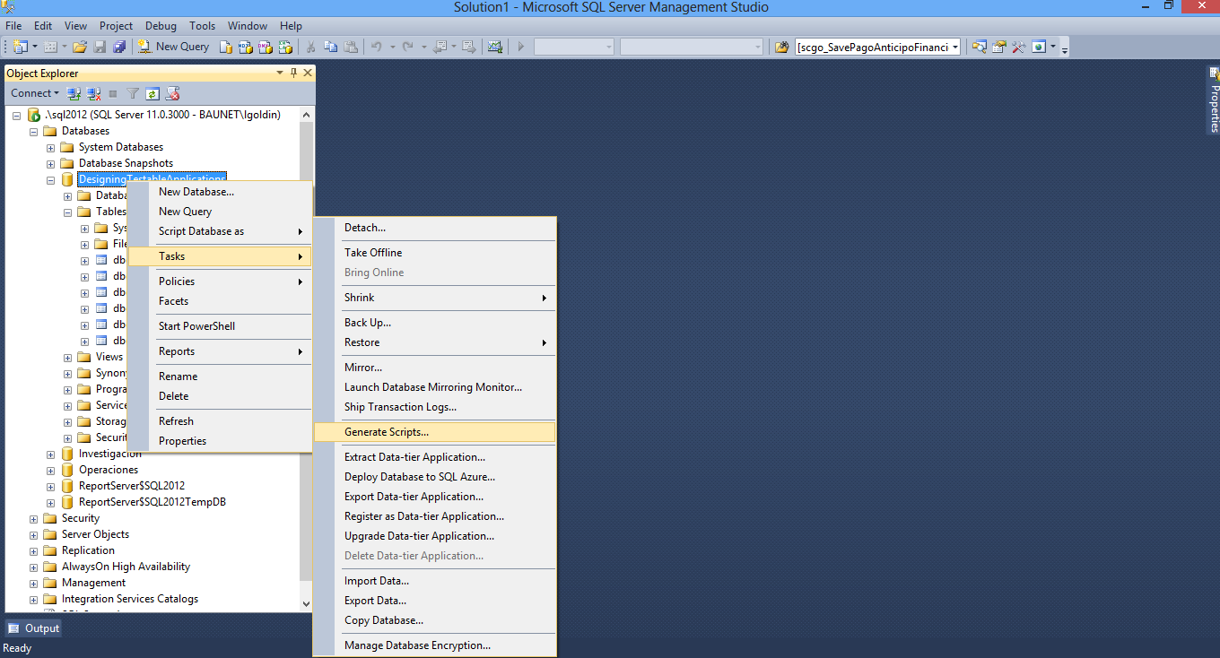
Tip 1: Generate creation scripts for DB, Tables, Views, SPs, Functions

Slide 6
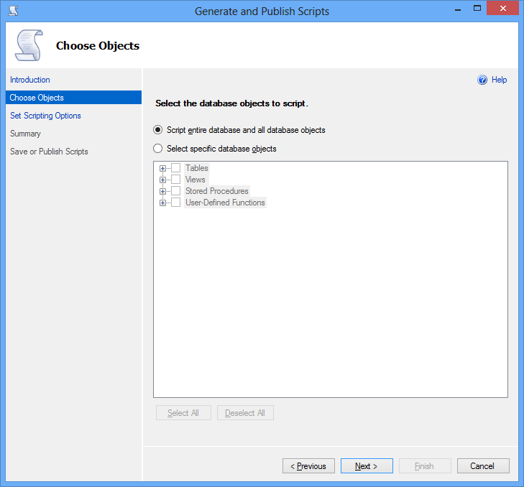
Tip 1: Generate creation scripts for DB, Tables, Views, SPs, Functions

Slide 7
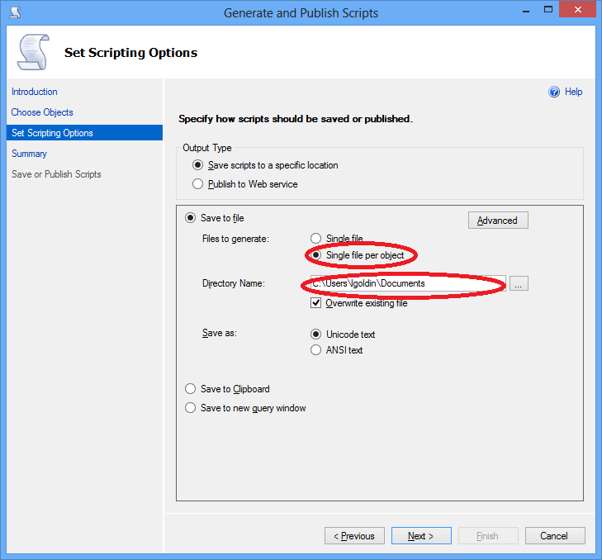
Tip 1: Generate creation scripts for DB, Tables, Views, SPs, Functions

Slide 8
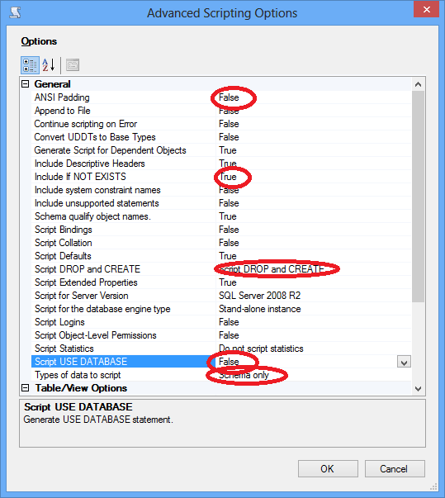
Tip 1: Generate creation scripts for DB, Tables, Views, SPs, Functions

Slide 9
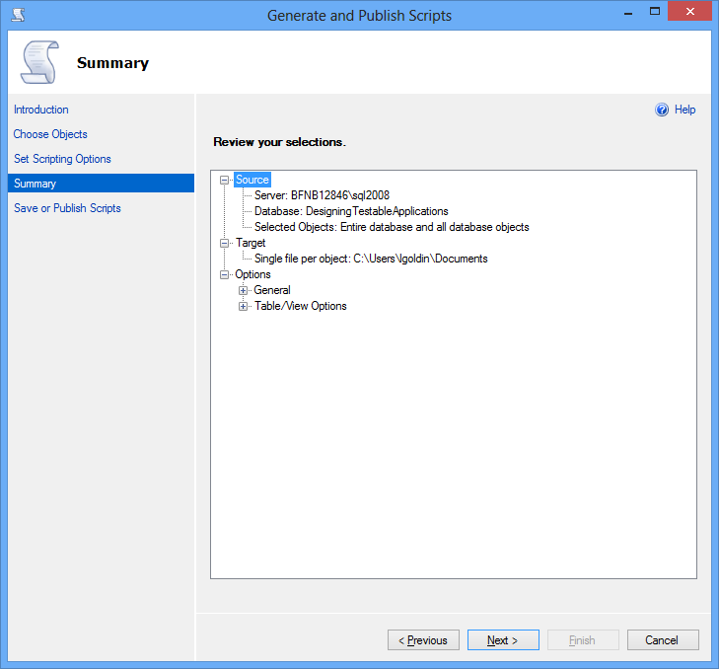
Tip 1: Generate creation scripts for DB, Tables, Views, SPs, Functions

Slide 10
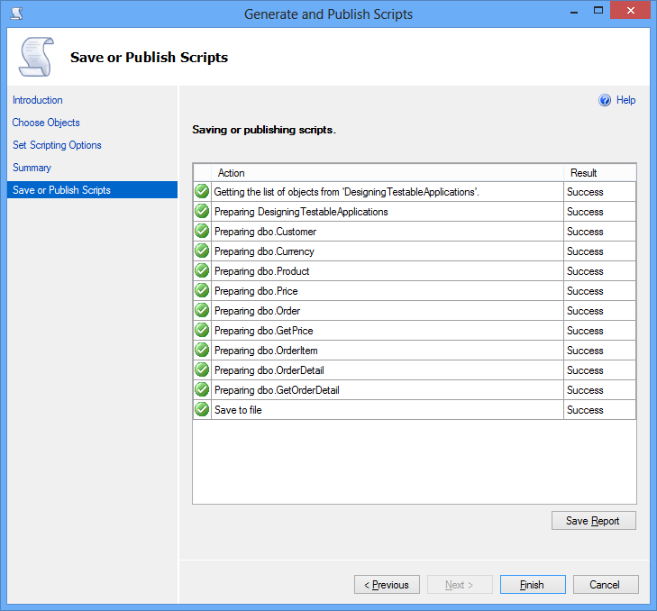
Tip 1: Generate creation scripts for DB, Tables, Views, SPs, Functions

Slide 11
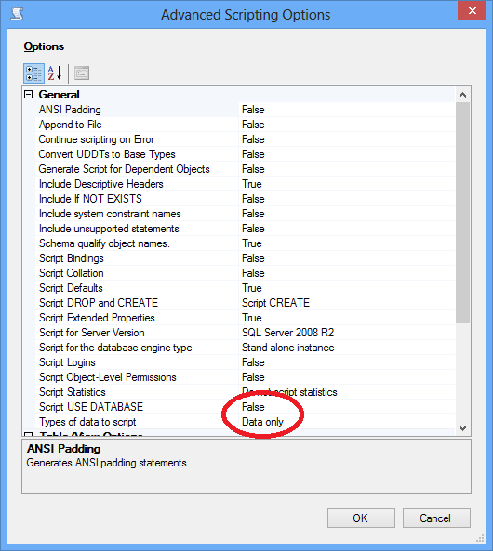
Tip 2: Generate “master” data insertion scripts

Slide 12
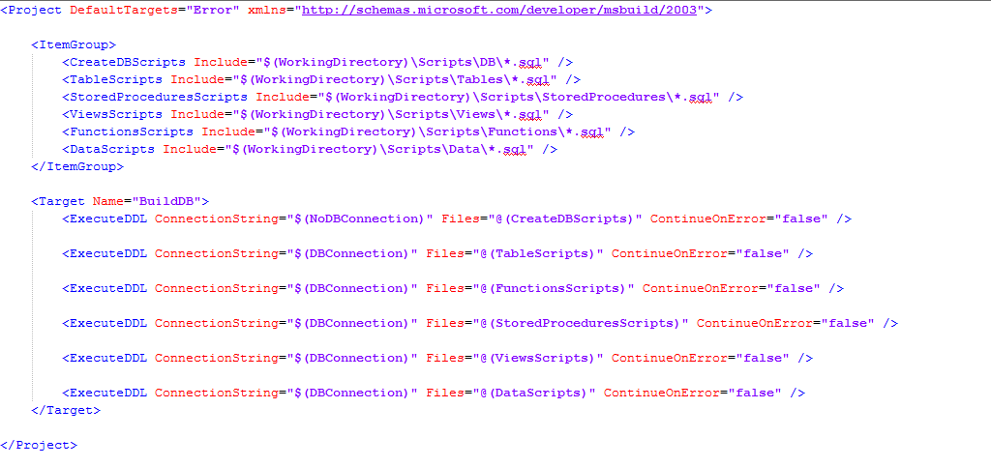
Tip 3: Execute scripts automatically

Slide 13
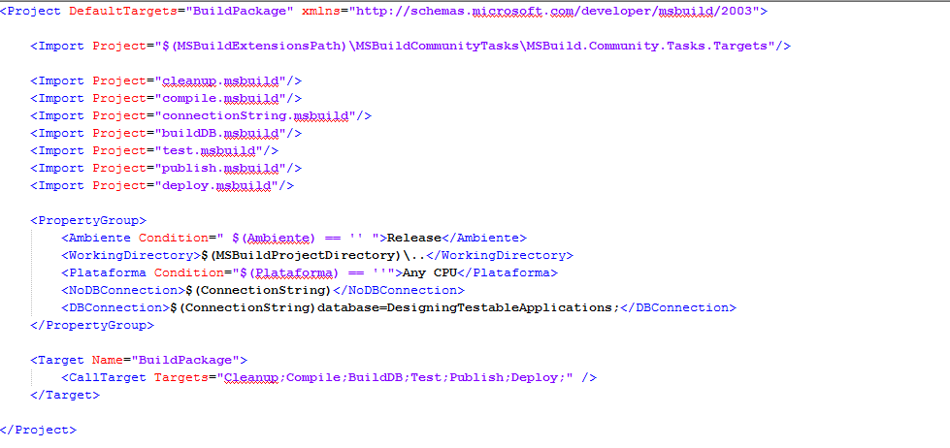
Tip 3: Execute scripts automatically

Slide 14
Tip 4: Setup test data (initialization & cleanup)
Abcdefghi

Slide 15
Tip 5: Generate Integration tests
Abcdefghi

Slide 16
Tip 6: Add Integration Tests to MSBuild
Abcdefghi

Slide 17
Legacy Code Refactoring: Tips & Samples

Slide 18
Tip 1: Decouple method code
Abcdefghi

Slide 19
Tip 2: Test method
Abcdefghi

Slide 20
Tip 3: Refactoring
Abcdefghi

Slide 21
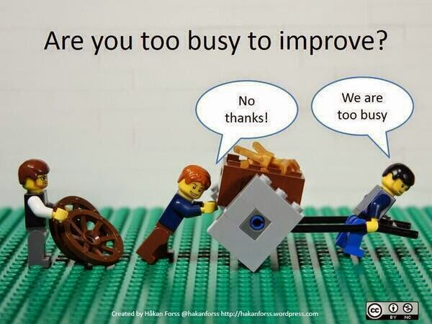
Tip 3: Refactoring

Slide 22
Coding time!

Slide 23

Questions

Slide 24
Feedback

Slide 25
Feedback
What do you think about using these practices in your projects?
What advantages would you have by incorporating these practices in your current project?
What’s your take on the concepts of today’s talk?

Slide 26
Summary

Slide 27
Summary
These practices:
Make your code more maintainable
Minimize the number of errors in the final product
Allow early detection of errors in the development environment
Reduce development and maintenance time over the project’s lifecycle
Improve the quality of the final product

Slide 28
Summary
These practices will also:
Improve the development team’s internal organization
Maintain a current build always available for testing, demos or deployment
Allow you to generate metrics of code quality, test coverage, etc.

Slide 29
Part III: Scenes of the next episode…
No, it’s over, just kidding…

Slide 30
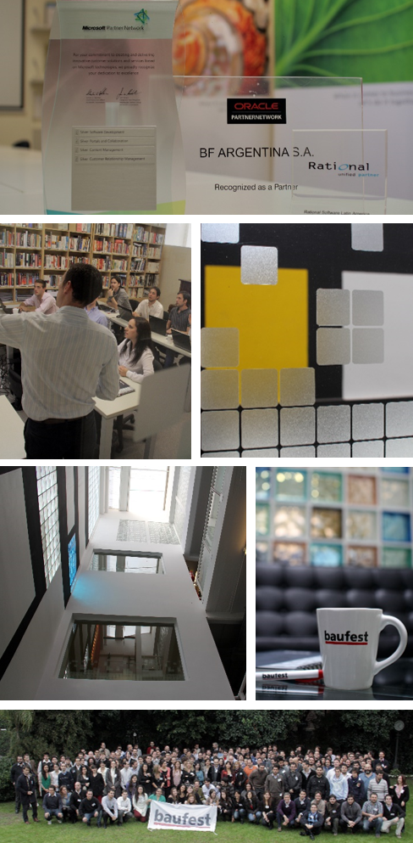





Thanks! Leandro Goldin lgoldin@baufest.com Christian Smirnoff csmirnoff@baufest.com
USA
Tel +1 (617) 275-2420 1 Broadway 14th floor Cambridge, MA 02142
USA
Mexico
Tel.: +52 (55) 5531-8878 Fax: +52 (55) 5531-8878 Avda. Ejército Nacional 678, Col. Polanco Reforma,
Distrito Federal C.P. 11550
México D.F.
Argentina
Buenos Aires
Tel.: +54 (11) 4118-8080
Fax: +54 (11) 4118-8080
Roosevelt 1655
C1428BNC, Buenos Aires
Argentina
Santa Fe
Tel.: +54 (342) 412-0368
San Jerónimo 1838
S3000FPP, Santa Fe
Argentina
Spain
Tel.: +34 91 745-2763
Fax: +34 91 561-5626
c/ Francisco Giralte, 2
28002, Madrid
Spain

